Slide 1
Contoso Real Estate Enterprise-grade Reference Architecture for JavaScript

Slide 2


Contoso Real Estate
Explore our Real-World e2e Sample
Enterprise-grade Reference Architecture for JavaScript with 8 core scenarios
Best-in-class developer tools from code to cloud
Notes:
Enterprise-grade Reference Architecture for JavaScript with 8 core scenarios
Contoso Real Estate is an Open-Source Enterprise-grade Reference Architecture for JavaScript based on a composable architecture with 8 core scenarios, showing best practices like monorepo usage (for multi-team and multi-project coordination), devcontainers (for Codespaces), built-in documentation (for self-guided exploration), micro-frontends, and more.
Best-in-class developer tools, from code to the cloud
From authoring in VS Code to testing with Playwright, deploying with Azure Dev CLI, automating with GitHub Actions, and featuring a fully fledged, no additional configuration needed, developer environment on Github Codespaces. Plus, early insights into using AI assistance with GitHub Copilot

Slide 3
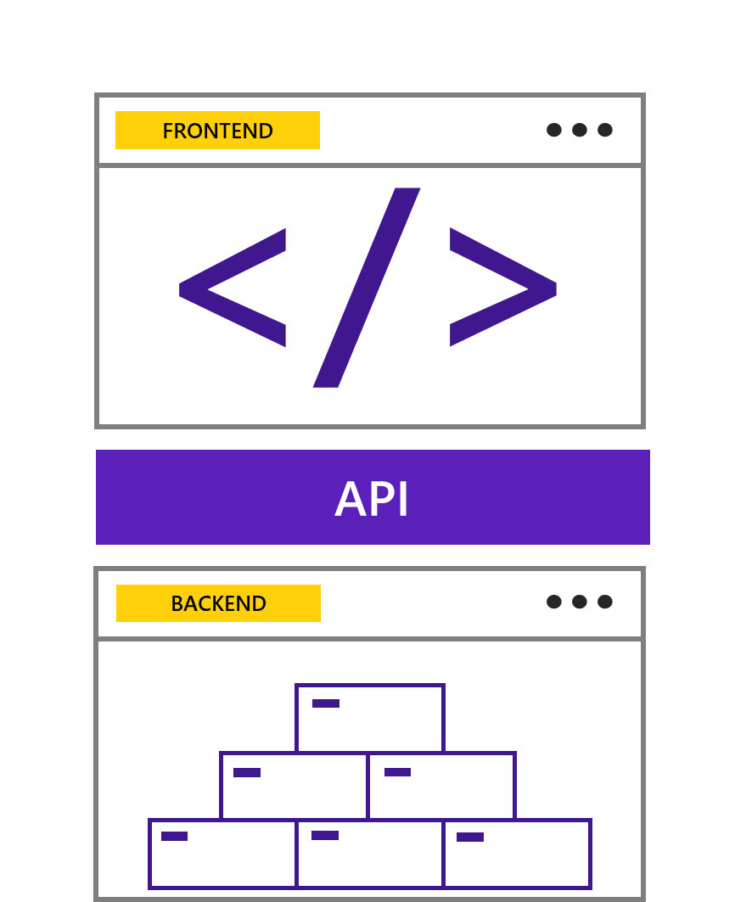
Composable Architecture?
Software architecture that divides the application into smaller parts, where each part is responsible for a specific functionality
Notes:
Composable architecture is a design pattern that allows developers to create reusable components to build applications more quickly and easily. This pattern has been gaining popularity in recent years as businesses strive to reduce the time needed to develop and deploy new applications.
Advantages of using composable architecture:
Reusability: components can be reused in different parts of the application.
Scalability: the application can be scaled horizontally; that is, it can be divided into smaller parts, and each part can be developed by a different team.
Maintainability: the application can be maintained more easily as each component is responsible for a specific functionality.

Slide 4
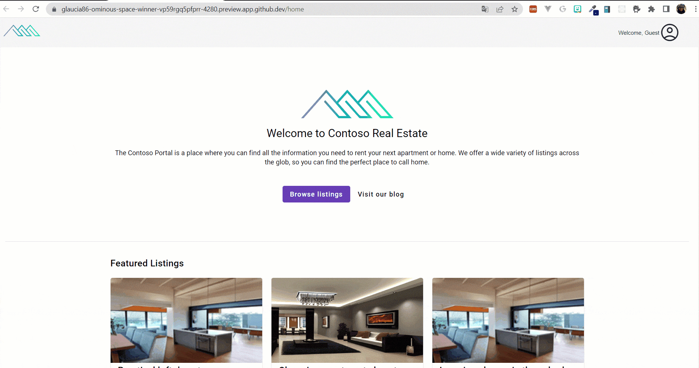
Notes:
Contoso Real Estate has 8 scenarios, including a static web app with a serverless backend, integrated monitoring and insights, micro-frontends, built-in authentication, containerized payments, intelligent search, and performance optimization.

Slide 5
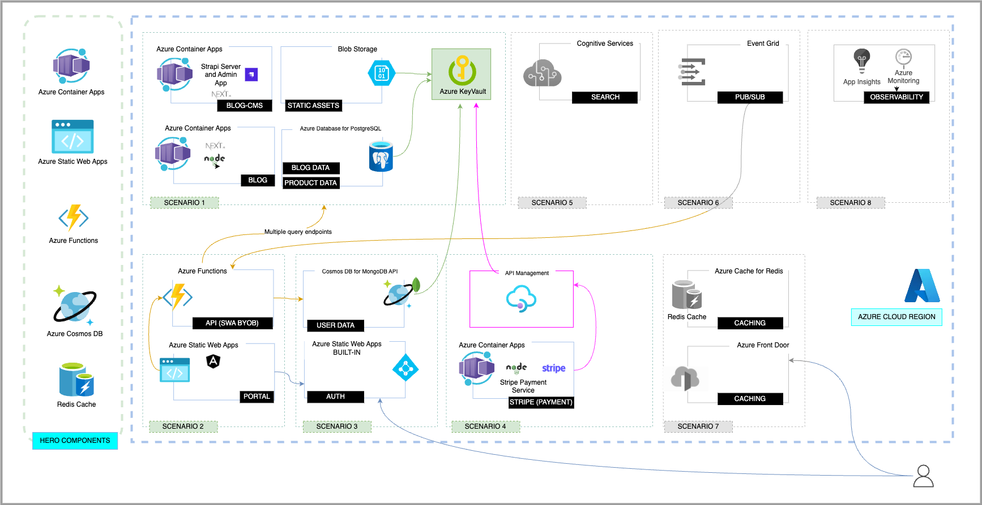
Notes:
Comments about the portal scenario

Slide 6






Everything you need to start your project
Get GitHub Copilot free for Students: https://aka.ms/Copilot4Students
Notes:
All you need to get started is a GitHub account to use Codespaces and Copilot and an Azure account to create the cloud services we'll learn about throughout the workshop.
If you're a student, you can sign up for the GitHub Student Developer Pack benefit program to get access to GitHub Copilot for free, 90 hours of GitHub Codespaces, and activate the Azure for Students offer, which gives you $100 in credits on Azure+ 25 free services for 1 year (can be renewed).

Slide 7
Quick and easy to create Set up fully configured cloud-hosted development environments in minutes
Easier remote work with cloud environments Work on multiple projects simultaneously without being slowed down by compute-intensive tasks
Develop wherever you are Edit, run, and debug apps from any device with an editor that supports Git repos, extensions, and CLI
Notes:
GitHub Codespaces is a cloud-hosted development environment. When you work in a Codespace, the environment you're working in is created using a development container, or dev container, hosted on a virtual machine. Development containers, or dev containers, are Docker containers that are specifically configured to provide a complete development environment. You can configure the dev container for a repository so that Codespaces created for that repository provide a custom development environment, complete with all the tools and runtimes you need to work on a specific project.

Slide 8
Convert comments to code GitHub Copilot uses the OpenAI Codex to suggest code and entire functions in real-time, right from your editor.
Autofill for repetitive code Quickly produces boilerplate and fills in repetitive code patterns
Show alternatives Show a list of solutions to use as provided, or edit to meet your needs
Notes:
GitHub Copilot is an AI pair programmer that offers autocomplete-style suggestions as you code. You can receive suggestions from GitHub Copilot either by starting to write the code you want to use, or by writing a natural language comment describing what you want the code to do. It is available where you want it. On your desktop using popular IDEs (Visual Studio Code, Visual Studio, JetBrains, Neovim) or in your browser using GitHub Codespaces.
GitHub Copilot is powered by Codex, a generative pretrained AI model created by OpenAI. It has been trained on natural language text and source code from publicly available sources, including code in public repositories on GitHub.

Slide 9
At this moment, you can run a demonstration of Contoso Real Estate on Codespace!

Slide 10
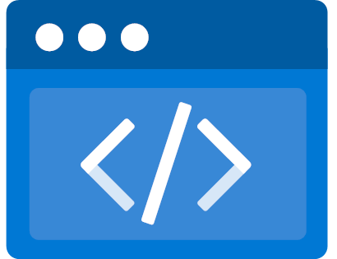
Azure Static Web Apps
Global hosting
Notes:
Azure Static Web Apps is a managed service that automatically builds and deploys full stack web apps to Azure from a code repository.
Global Hosting
Fully managed global distribution
Bring your content closer to your customers
Scale faster
Enterprise-grade edge
Enhanced security, and increased reliability without requiring configuration or coding.
Managed Azure Front Door can be used to significantly reduce latency and increase throughput
Key features
Web hosting for static content like HTML, CSS, JavaScript, and images.
Integrated API support provided by Azure Functions with the option to link an existing Azure Functions app using a standard account.
First-class GitHub and Azure DevOps integration where repository changes trigger builds and deployments.
Globally distributed static content, putting content closer to your users.
Free SSL certificates, which are automatically renewed.
Custom domains to provide branded customizations to your app.
Seamless security model with a reverse-proxy when calling APIs, which requires no CORS configuration.
Authentication provider integrations with Azure Active Directory, GitHub, and Twitter.
Customizable authorization role definition and assignments.
Back-end routing rules enabling full control over the content and routes you servGenerated staging versions powered by pull requests enabling preview versions of your site before publishing.
CLI support through the Azure CLI to create cloud resources, and via the Azure Static Web Apps CLI for local development.

Slide 11
Azure Static Web Apps
Global hosting
End-to-end development experience
Notes:
End-to-end development experience
Best-in-class end-to-end development experience
from developing and debugging to monitoring and deploying with built-in DevOps capabilities.
Tailored VS Code extension
to easily create static web apps, extend with serverless APIs, and establish a deployment workflow.
Powerful Command Line Interface (CLI)
provides a high-fidelity local replica of the cloud production environment with mocked hosting platform features for authentication, custom routing, and authorization rules to support local development.

Slide 12
Azure Static Web Apps
Global hosting
End-to-end development experience
Streamlined build and deployment
Notes:
Streamlined build and deployment
Code change driven app building and deployment
interacts directly with GitHub or Azure DevOps to monitor a branch of your choice and automatically builds and deploys apps and API to Azure.
Workflow based pre-production environment build
stage the app and enables you to perform reviews before pushing to production.
Multiple pre-production environments
can co-exist at the same time when using Azure Static Web Apps. Each time you create a pull request against the watched branch, a staged version with your changes is deployed to a distinct pre-production environment.

Slide 13

Azure Static Web Apps
Global hosting
End-to-end development experience
Streamlined build and deployment
Fully managed and cost-effective
Notes:
Fully managed and cost-effective
A serverless approach with auto scaling keep costs low by matching resources to demand. Suitable for small spiky loads to large sites with sustained traffic.
Serverless pricing model means you only pay for what you use. No need for idle capacity management and resource over-provisioning.
Automatic handling of all maintenance and updates
Always-on traffic monitoring and real-time mitigation
Built-in authentication and routing rules

Slide 14

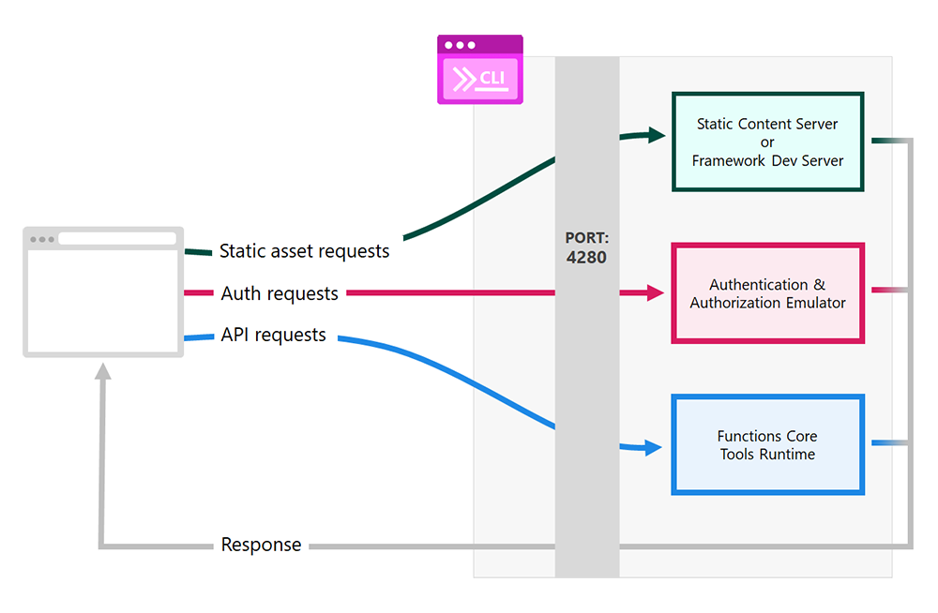
Azure Static Web Apps (SWA) CLI
Manage the e2e communication
Deploy on Azure
#
#
Notes:
The standard communication structure between frontend and backend in an Angular project is through a services.ts. In the portal project of Contoso Real Estate, the communication between frontend and backend and the deployment are managed through the Azure Static Web App CLI.
In terms of execution of the project, the SWA CLI intercepts and forwards HTTP requests to the right components based on purpose when calling APIs, which requires no CORS configuration. If you are running Contoso, you will see the portal available on the 4280 port (check the Ports tab on Codespaces) because it is the default port of the ASWA.

Slide 15

GitHub Student Developer Pack (including Azure for Students)
aka.ms/Copilot4Students
Azure Free Trial
aka.ms/azure/free-trial
GitHub Codespaces
github.com/features/codespaces
GitHub Copilot (60-day trial)
github.com/features/copilot
Notes:
Note: you can show how to enable codespaces https://docs.github.com/en/codespaces/getting-started/quickstart
Copilot offers 60-day trial

